Slide 1
Programming With C++/R
DST102TC
Huakang Li
Huakang.li@xjtlu.edu.cn
School of AI and Advanced Computing
Notes:
English Title: Uppercase, Calibri size 60, XJTLU Navy
English Subtitle: Uppercase, Calibri size 36, XJTLU Navy

Slide 2
Chapter 8
Multidimensional Arrays
Notes:
English Title: Uppercase, Calibri size 60, XJTLU Navy
English Subtitle: Uppercase, Calibri size 36, XJTLU Navy

Slide 3
Objectives
To give examples of representing data using two-dimensional arrays (§8.1).
To declare two-dimensional arrays and access array elements in a two-dimensional array using row and column indexes (§8.2).
To process two-dimensional arrays (§8.3).
To pass two-dimensional arrays to functions (§8.4).
To write a program for grading multiple-choice questions using two-dimensional arrays (§8.5).
To solve the closest-pair problem using two-dimensional arrays (§8.6).
To solve the Sudoku problem using two-dimensional arrays (§8.7).
To declare multidimensional arrays (§8.8).

Slide 4
Two-dimensional Arrays
// Declare array ref var
elementType arrayName[rowSize][columnSize];
int matrix[5][5];

Slide 5
Two-dimensional Array Illustration

Slide 6
Declaring, Creating, and Initializing Using Shorthand Notations
You can also use an array initializer to declare, create and initialize a two-dimensional array. For example,

Slide 7
Initializing Arrays with Random Values
The following loop initializes the array with random values between 0 and 99:
for (int row = 0; row < rowSize; row++)
{
for (int column = 0; column < columnSize; column++)
{
matrix[row][column] = rand() % 100;
}
}

Slide 8
Printing Arrays
To print a two-dimensional array, you have to print each element in the array using a loop like the following:
for (int row = 0; row < rowSize; row++)
{
for (int column = 0; column < columnSize; column++)
{
cout << matrix[row][column] << " ";
}
cout << endl;
}

Slide 9
Summing All Elements
To print a two-dimensional array, you have to print each element in the array using a loop like the following:
for (int row = 0; row < rowSize; row++)
{
for (int column = 0; column < columnSize; column++)
{
cout << matrix[row][column] << " ";
}
cout << endl;
}

Slide 10
Summing Elements by Column
For each column, use a variable named total to store its sum. Add each element in the column to total using a loop like this:
for (int column = 0; column < columnSize; column++)
{
int total = 0;
for (int row = 0; row < rowSize; row++)
total += matrix[row][column];
cout << "Sum for column " << column << " is " << total << endl;
}

Slide 11
Which row has the largest sum?
Use variables maxRow and indexOfMaxRow to track the largest sum and index of the row. For each row, compute its sum and update maxRow and indexOfMaxRow if the new sum is greater.

Slide 12
Passing Two-Dimensional Arrays to Functions
You can pass a two-dimensional array to a function; however, C++ requires that the column size to be specified in the function declaration.
Listing 8.1 gives an example with a function that returns the sum of all the elements in a matrix.

Slide 13
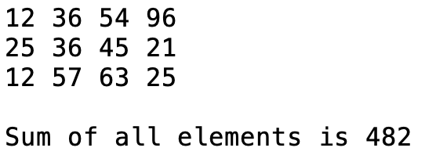
PassTwoDimensionalArray.cpp
#include <iostream>
using namespace std;
const int COLUMN_SIZE = 4;
int sum(const int a[][COLUMN_SIZE], int rowSize)
{
int total = 0;
for (int row = 0; row < rowSize; row++)
{
for (int column = 0; column < COLUMN_SIZE; column++)
{
total += a[row][column];
}
}
return total;
}
int main()
{
const int ROW_SIZE = 3;
int m[ROW_SIZE][COLUMN_SIZE];
cout << "Enter " << ROW_SIZE << " rows and "
<< COLUMN_SIZE << " columns: " << endl;
for (int i = 0; i < ROW_SIZE; i++)
for (int j = 0; j < COLUMN_SIZE; j++)
cin >> m [i][j];
cout << "\nSum of all elements is " << sum(m, ROW_SIZE) << endl;
return 0;
}

Slide 14
Example: Grading Multiple-Choice Test
Objective: write a program that grades multiple-choice test.

Slide 15
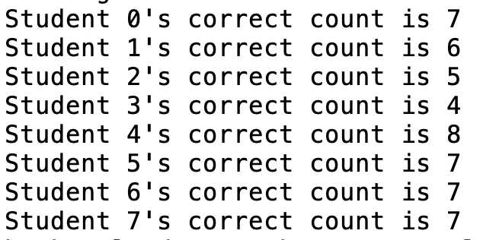
GradeExam.cpp
// Key to the questions
char keys[] = {'D', 'B', 'D', 'C', 'C', 'D', 'A', 'E', 'A', 'D'};
// Grade all answers
for (int i = 0; i < NUMBER_OF_STUDENTS; i++)
{
// Grade one student
int correctCount = 0;
for (int j = 0; j < NUMBER_OF_QUESTIONS; j++)
{
if (answers[i][j] == keys[j])
correctCount++;
}
cout << "Student " << i << "'s correct count is " <<
correctCount << endl;
}
return 0;
}
#include <iostream>
using namespace std;
int main()
{
const int NUMBER_OF_STUDENTS = 8;
const int NUMBER_OF_QUESTIONS = 10;
// Students' answers to the questions
char answers[NUMBER_OF_STUDENTS][NUMBER_OF_QUESTIONS] =
{
{'A', 'B', 'A', 'C', 'C', 'D', 'E', 'E', 'A', 'D'},
{'D', 'B', 'A', 'B', 'C', 'A', 'E', 'E', 'A', 'D'},
{'E', 'D', 'D', 'A', 'C', 'B', 'E', 'E', 'A', 'D'},
{'C', 'B', 'A', 'E', 'D', 'C', 'E', 'E', 'A', 'D'},
{'A', 'B', 'D', 'C', 'C', 'D', 'E', 'E', 'A', 'D'},
{'B', 'B', 'E', 'C', 'C', 'D', 'E', 'E', 'A', 'D'},
{'B', 'B', 'A', 'C', 'C', 'D', 'E', 'E', 'A', 'D'},
{'E', 'B', 'E', 'C', 'C', 'D', 'E', 'E', 'A', 'D'}
};

Slide 16
Problem: Finding Two Points Nearest to Each Other

Slide 17
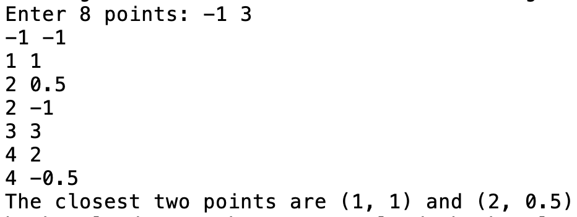
// Compute distance for every two points
for (int i = 0; i < NUMBER_OF_POINTS; i++)
{
for (int j = i + 1; j < NUMBER_OF_POINTS; j++)
{
double distance = getDistance(points[i][0], points[i][1],
points[j][0], points[j][1]); // Find distance
if (shortestDistance > distance)
{
p1 = i; // Update p1
p2 = j; // Update p2
shortestDistance = distance; // Update shortestDistance
}
}
}
// Display result
cout << "The closest two points are " <<
"(" << points[p1][0] << ", " << points[p1][1] << ") and (" <<
points[p2][0] << ", " << points[p2][1] << ")" << endl;
return 0;
}
FindNearestPoints.cpp
#include <iostream>
#include <cmath>
using namespace std;
// Compute the distance between two points (x1, y1) and (x2, y2)
double getDistance(double x1, double y1, double x2, double y2)
{
return sqrt((x2 - x1) * (x2 - x1) + (y2 - y1) * (y2 - y1));
}
int main()
{
const int NUMBER_OF_POINTS = 8;
// Each row in points represents a point
double points[NUMBER_OF_POINTS][2];
cout << "Enter " << NUMBER_OF_POINTS << " points: ";
for (int i = 0; i < NUMBER_OF_POINTS; i++)
cin >> points[i][0] >> points[i][1];
// p1 and p2 are the indices in the points array
int p1 = 0, p2 = 1; // Initial two points
double shortestDistance = getDistance(points[p1][0], points[p1][1],
points[p2][0], points[p2][1]); // Initialize shortestDistance

Slide 18
Case Study: Sudoku
The objective is to fill the grid (see the left figure) so that every row, every column, and every 3×3 box contain the numbers 1 to 9, as shown in the right figure.

Slide 19
Case Study: Sudoku
Rule 1: Fill in an empty cell from the first to the last.
Rule 2: Fill in a smallest number possible.
Rule 3: If no number can fill in a cell, backtrack.

Slide 20
What is Sudoku?

Slide 21
Every row contains the numbers 1 to 9

Slide 22
Every column contains the numbers 1 to 9
5 3
4
6
7
8
9
1
2
6
7
2
1 9 5
3
4
8
1
9 8
3
4
2
5
6
7
8
5
9
7
6
1
4
2
3
4
2
6
8
5
3
7
9
1
7
1
3
9
2
4
8
5
6
9
6
1
5
3
7
2
8
4
2
8
7
4 1 9
6
3
5
3
4
5
2
8
6
1
7 9

Slide 23
Every 3×3 box contains the numbers 1 to 9
5 3
4
6
7
8
9
1
2
6
7
2
1 9 5
3
4
8
1
9 8
3
4
2
5
6
7
8
5
9
7
6
1
4
2
3
4
2
6
8
5
3
7
9
1
7
1
3
9
2
4
8
5
6
9
6
1
5
3
7
2
8
4
2
8
7
4 1 9
6
3
5
3
4
5
2
8
6
1
7 9

Slide 24
Checking Whether a Solution Is Correct

Slide 25
CheckSudokuSolution.cpp
// Check whether the fixed cells are valid in the grid
bool isValid(const int grid[][9])
{
for (int i = 0; i < 9; i++)
for (int j = 0; j < 9; j++)
if (grid[i][j] < 1 || grid[i][j] > 9 ||
!isValid(i, j, grid))
return false;
return true; // The fixed cells are valid
}
// Check whether grid[i][j] is valid in the grid
bool isValid(int i, int j, const int grid[][9])
{
// Check whether grid[i][j] is valid at the i's row
for (int column = 0; column < 9; column++)
if (column != j && grid[i][column] == grid[i][j])
return false;
// Check whether grid[i][j] is valid at the j's column
for (int row = 0; row < 9; row++)
if (row != i && grid[row][j] == grid[i][j])
return false;
// Check whether grid[i][j] is valid in the 3-by-3 box
for (int row = (i / 3) * 3; row < (i / 3) * 3 + 3; row++)
for (int col = (j / 3) * 3; col < (j / 3) * 3 + 3; col++)
if (row != i && col != j && grid[row][col] == grid[i][j])
return false;
return true; // The current value at grid[i][j] is valid
}
#include <iostream>
using namespace std;
void readASolution(int grid[][9]);
bool isValid(const int grid[][9]);
bool isValid(int i, int j, const int grid[][9]);
int main()
{
// Read a Sudoku puzzle
int grid[9][9];
readASolution(grid);
cout << (isValid(grid) ? "Valid solution" : "Invalid solution");
return 0;
}
/** Read a Sudoku puzzle from the keyboard */
void readASolution(int grid[][9])
{
cout << "Enter a Sudoku puzzle:" << endl;
for (int i = 0; i < 9; i++)
for (int j = 0; j < 9; j++)
cin >> grid[i][j];
}

Slide 26
Multidimensional Arrays
In the preceding section, you used a two-dimensional array to represent a matrix or a table. Occasionally, you will need to represent n-dimensional data structures. In C++, you can create n-dimensional arrays for any integer n.
The way to declare two-dimensional array can be generalized to declare n-dimensional array for n >= 3. For example, the following syntax declares a three-dimensional array scores.
double scores[10][5][2];

Slide 27
Problem: Daily Temperature and Humidity
Suppose a meteorology station records the temperature and humidity at each hour of every day and stores the data for the past ten days in a text file named weather.txt. Each line of the file consists of four numbers that indicates the day, hour, temperature, and humidity. The contents of the file may look like the one in (a):
Your task is to write a program that calculates the average daily temperature and humidity for the 10 days.

Slide 28
Weather.cpp
// Find the average daily temperature and humidity
for (int i = 0; i < NUMBER_OF_DAYS; i++)
{
double dailyTemperatureTotal = 0, dailyHumidityTotal = 0;
for (int j = 0; j < NUMBER_OF_HOURS; j++)
{
dailyTemperatureTotal += data[i][j][0];
dailyHumidityTotal += data[i][j][1];
}
// Display result
cout << "Day " << i << "'s average temperature is "
<< dailyTemperatureTotal / NUMBER_OF_HOURS << endl;
cout << "Day " << i << "'s average humidity is "
<< dailyHumidityTotal / NUMBER_OF_HOURS << endl;
}
return 0;
}
#include <iostream>
using namespace std;
int main()
{
const int NUMBER_OF_DAYS = 10;
const int NUMBER_OF_HOURS = 24;
double data[NUMBER_OF_DAYS][NUMBER_OF_HOURS][2];
// Read input using input redirection from a file
int day, hour;
double temperature, humidity;
for (int k = 0; k < NUMBER_OF_DAYS * NUMBER_OF_HOURS; k++)
{
cin >> day >> hour >> temperature >> humidity;
data[day - 1][hour - 1][0] = temperature;
data[day - 1][hour - 1][1] = humidity;
}

Slide 29
Problem: Guessing Birthday
Listing 4.4, GuessBirthday.cpp, gives a program that guesses a birthday. The program can be simplified by storing the numbers in five sets in a three-dimensional array, and it prompts the user for the answers using a loop.

Slide 30
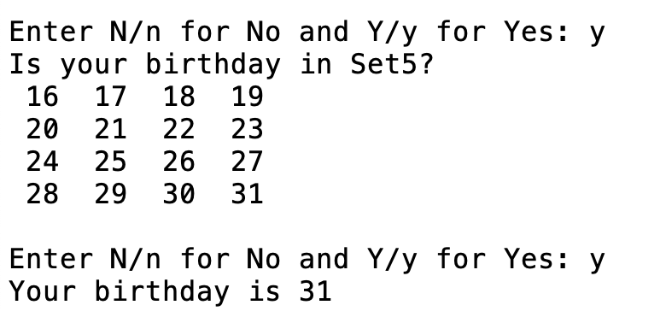
GuessBirthdayUsingArray.cpp
for (int i = 0; i < 5; i++)
{
cout << "Is your birthday in Set" << (i + 1) << "?" << endl;
for (int j = 0; j < 4; j++)
{
for (int k = 0; k < 4; k++)
cout << setw(3) << dates[i][j][k] << " ";
cout << endl;
}
cout << "\nEnter N/n for No and Y/y for Yes: ";
cin >> answer;
if (answer == 'Y' || answer == 'y')
day += dates[i][0][0];
}
cout << "Your birthday is " << day << endl;
return 0;
}
#include <iostream>
#include <iomanip>
using namespace std;
int main()
{
int day = 0; // Day to be determined
char answer;
int dates[5][4][4] = {
{{ 1, 3, 5, 7},
{ 9, 11, 13, 15},
{17, 19, 21, 23},
{25, 27, 29, 31}},
{{ 2, 3, 6, 7},
{10, 11, 14, 15},
{18, 19, 22, 23},
{26, 27, 30, 31}},
{{ 4, 5, 6, 7},
{12, 13, 14, 15},
{20, 21, 22, 23},
{28, 29, 30, 31}},
{{ 8, 9, 10, 11},
{12, 13, 14, 15},
{24, 25, 26, 27},
{28, 29, 30, 31}},
{{16, 17, 18, 19},
{20, 21, 22, 23},
{24, 25, 26, 27},
{28, 29, 30, 31}}};
All Select isY

Slide 31
summarization
Two-Dimensional Arrays
Arrays IO
CaseStudy

Slide 32
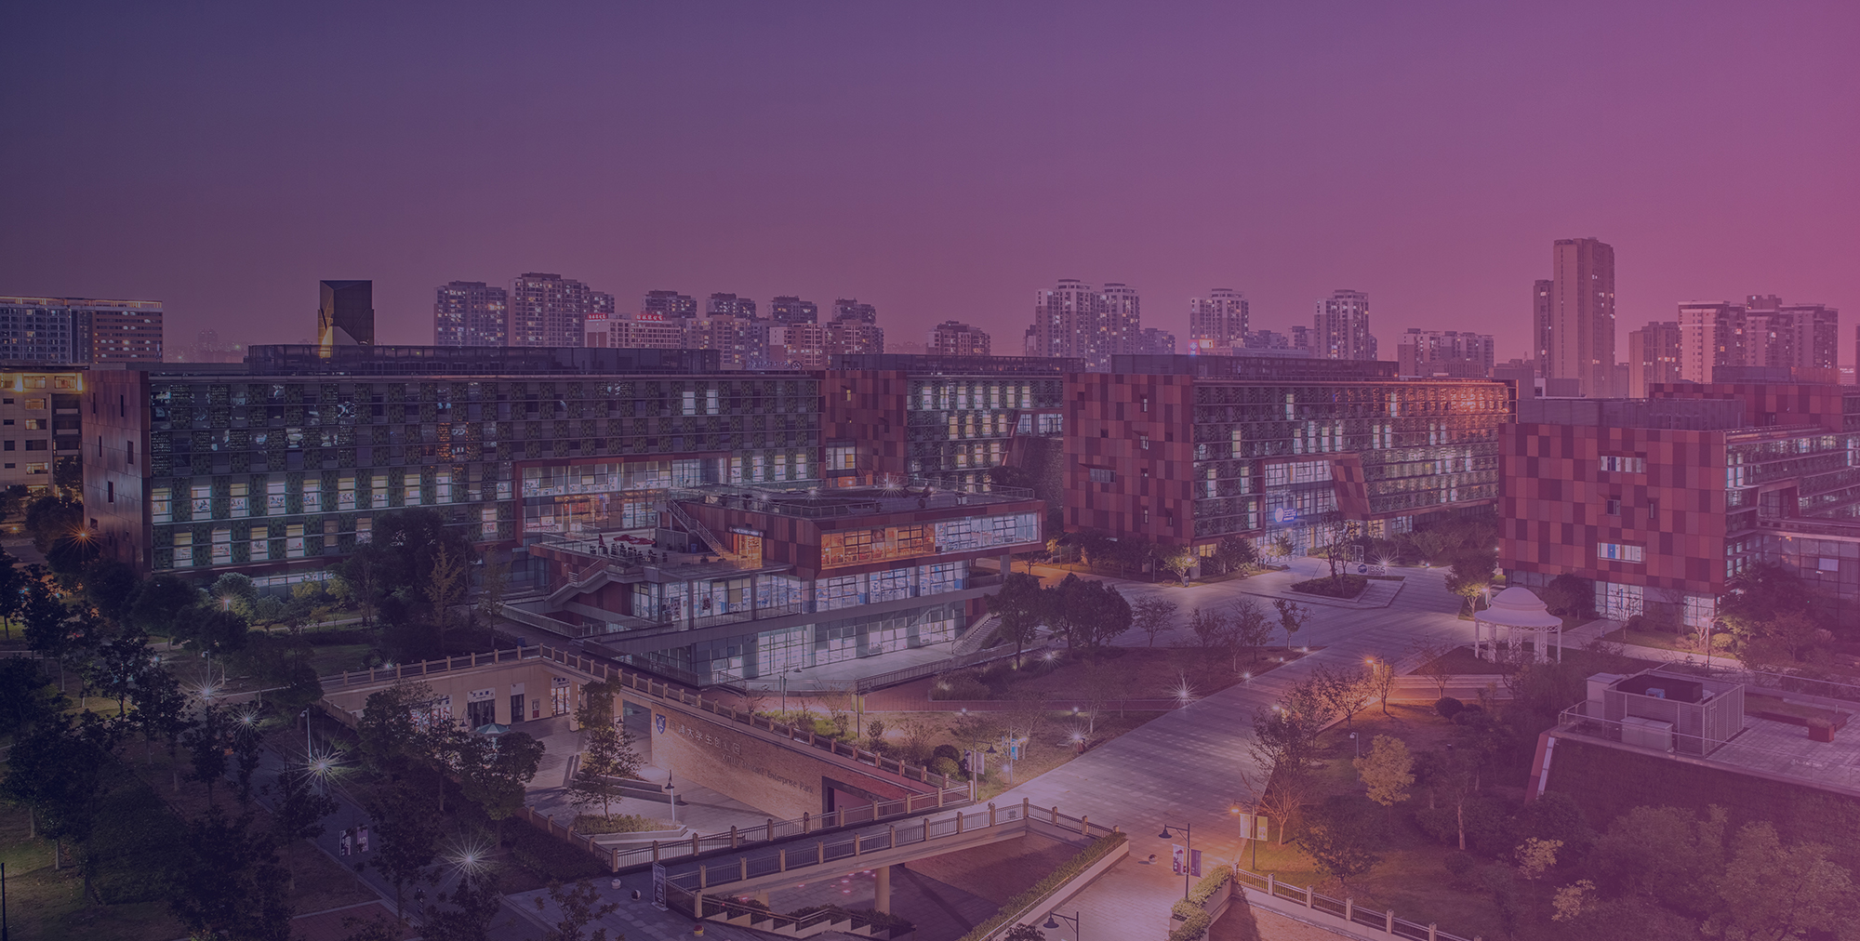


THANK YOU
Visit us
FOLLOW us
www.xjtlu.edu.cn
Notes:
Title: Uppercase, Calibri size 60, XJTLU Navy

